Slide 1
Debating the European Union
on February 5 2022 by Andras Meleg

Slide 2
Goals and survey
What are you the most interested in?
What is your debating level?

Slide 3
Historical concept of the EU
Crisis after World War II → Marshall Plan
Way for effective cooperation
The treaties are the cornerstones, and can come handy if you know them → (include them to your casefiles)
Starts as an economic cooperation
Becomes a political cooperation

Slide 4
Basics: 4 Freedoms

Slide 5
Basics: 4 Freedoms
Free movement of goods.

Slide 6
Basics: 4 Freedoms
Free movement of goods.
Free movement of capital.

Slide 7
Basics: 4 Freedoms
Free movement of goods.
Free movement of capital.
Freedom to establish and provide services.

Slide 8
Basics: 4 Freedoms
Free movement of goods.
Free movement of capital.
Freedom to establish and provide services.
Free movement of persons.

Slide 9
Basics: 4 Freedoms
Free movement of goods.
Free movement of capital.
Freedom to establish and provide services.
Free movement of persons.
WHY are these IMPORTANT?

Slide 10
Free movement of persons
Travelling, Erasmus, Erasmus+, etc.
Cultural connection
WHY did NOT happen BEFORE?
1: History (wars)
2: Lack of infrastructure
3: Demand
Practice: should people spend holidays abroad or in their home country?

Slide 11
Free movement of goods & capital
WHY is trade better?
1: comparative advantages
2: peace
3: scale-advantage
Every transaction that A & B : no transaction between B & C

Slide 12
Free movement of services
Basically it means the ease of regulations
Result: other businesses can come here more easily
Impact: New ideas can flow in more easily
Danger: „Polish-plumbers”
Story: SU in Denmark
Few examples of these services: food franchises, international travel, IT companies

Slide 13
What is NOT in the 4 freedoms?
1: political union
2: legislative union
3: military union
4: is there an „ideal” size?

Slide 14
Clashpoint 1: Sovereignty
Almost every EU debate has this
EU Council: 1 country 1 vote
How is this changing?
1: Committee: who gets into positions?
2: Eurozone and economic power
3: European Parliament → elected by the people

Slide 15
Clashpoint 1: Sovereignty
Almost every EU debate has this
EU Council: 1 country 1 vote
How is this changing?
1: Committee: who gets into positions?
2: Eurozone and economic power
3: European Parliament → elected by the people

Slide 16
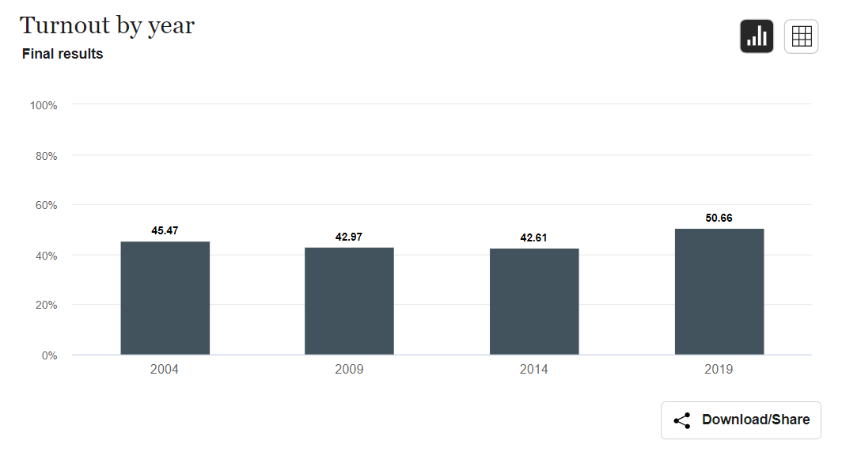
What happened in 2019?
EU Parliament turnout:
Younger generation voted
Made traditional parties weaker
What will happen next?

Slide 17
Clashpoint 2: Euro
Where does the value of money come from?
TRUST
Supply + Demand → people buy currency
Why Germany wants to undervalue its money? → wins on „export”
Example: sells something for 100$ to the US → gets more money
Why Greece wants euro? → safety and stability

Slide 18
Practice 1
THW give the European Parliament the right to make foreign policy decisions!
(Status Quo: European Council makes foreign policy decisions)
Each group should bring 3 arguments

Slide 19
Pratice 2
THBT unemployment is a European issue rather than a national issue
How the government world looks like?
Why is unemployment important for the EU?
What are good arguments on each side?

Slide 20
Game: Argument lotto
Choose from these 4 motions:
1: THW set up a common European Military
2: THR the EU’s migration policy
3: THBT the veto rights in EU Council does more harm than good
4: THS a European minimal wage

Slide 21
Argument lotto
Find and agree one the 3 strongest arguments for your team

Slide 22
Argument lotto
Find and agree one the 3 strongest arguments for your team
Now your pair group should guess what were your 3 strongest arguments (You get 1 point for each)

Slide 23
Argument lotto
Find and agree one the 3 strongest arguments for your team
Now your pair group should guess what were your 3 strongest arguments (You get 1 point for each)
Now try and rebutt the other team’s strongest arguments, first team A, then team B. Vote after every 1 minute rebuttal, and if you accept it as a good rebuttal, your team gets 1 point.

